Slide 1
Treatment of Non-Small Cell Lung Cancer in 2025
Gregory J. Riely
March 8, 2025

Slide 2
NSCLC outline:
Biology/biomarkers in NSCLC
Surgically resectable disease
Unresectable stage III
Targeted therapies in metastatic disease
Treatment of metastatic disease without oncogenic drivers

Slide 3
How do we describe NSCLC in 2025?
Histology
Biomarkers
Stage

Slide 4
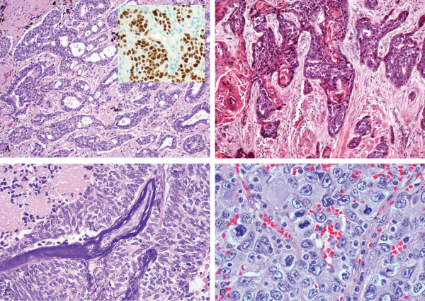
How do we describe NSCLC in 2025?
Squamous
Other
Adenocarcinoma
~25%
~10%
Squamous Cell Carcinoma
p63 (p40)
Adenocarcinoma
TTF-1, Napsin A

Slide 5
Classification of NSCLC by biomarkers
Mutations/Gene Fusions (by NGS)

Slide 6
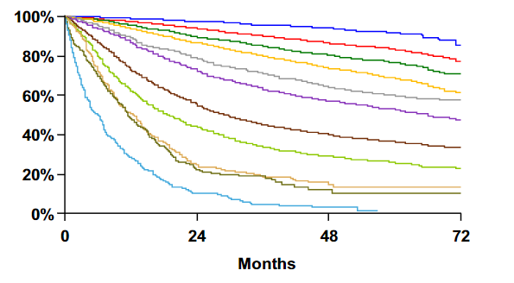
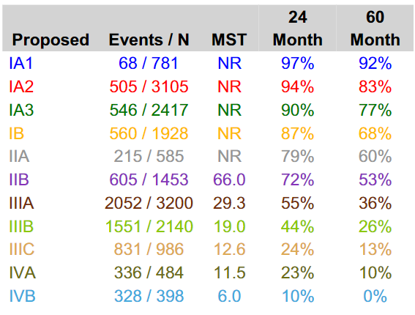
Outcomes by pathologic stage for NSCLC (v8)
Surgically resected patients, 1999 – 2010
Overall Survival
1
3
7
9
Goldstraw, et al. J Thorac Oncol. 2015
Notes:
6
6

Slide 7
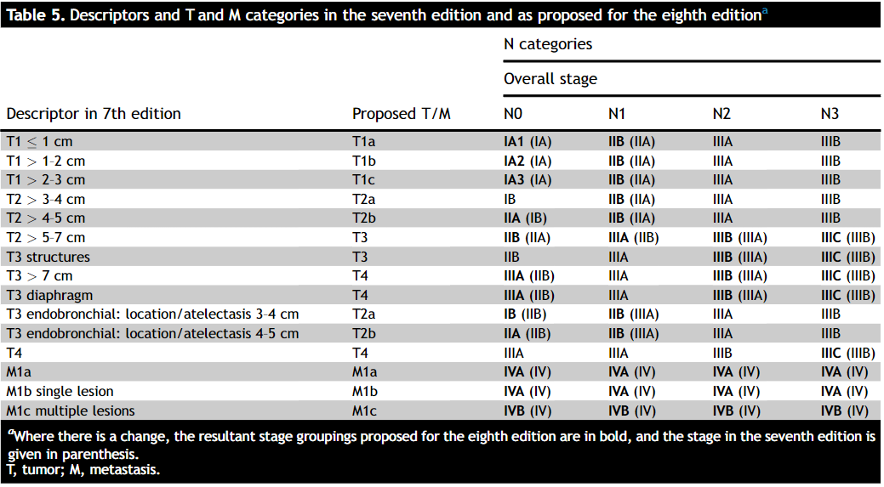
For the compulsive…
Many recent adjuvant/neoadjucant trials were based on AJCC v7 and current system is v8.
Trials included tumors >4 cm, which were once stage IB, but now stage II
Trials included N2 patients, some of which are now stage IIIB
Goldstraw et al, JTO 2016

Slide 8
68 year-old woman with resected Stage II (T1N1) NSCLC. Tumor histology is adenocarcinoma. No EGFR mutation. PD-L1 60%. What is the most appropriate adjuvant therapy?
Atezolizumab
Cisplatin, pemetrexed, pembrolizumab
Cisplatin, pemetrexed
Cisplatin, pemetrexed followed by atezolizumab
Concurrent carboplatin, paclitaxel, and radiation therapy

Slide 9
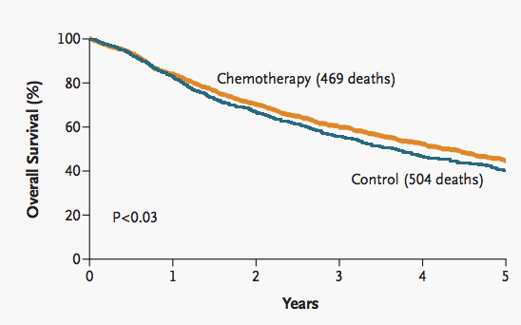
How did we treat early-stage NSCLC?
After IALT, etc.
mid-2000’s onward
surgery
chemotherapy
OS HR=0.86 p<0.03
DFS HR=0.83 p<0.003
Studies at this time gave:
cisplatin+ vinca alkaloids
or cisplatin + etoposide
IALT NEJM 2004

Slide 10
How did we treat early-stage NSCLC?
surgery
chemotherapy
Chemotherapy useful for Stages II and III
Modified from Pignon JP et al. J Clin Oncol 2008 Jul 20;26(21):3552-9

Slide 11
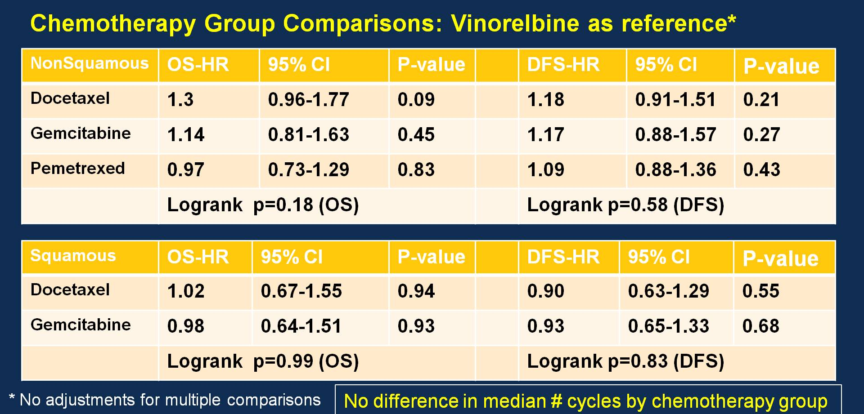
How did we treat early-stage NSCLC?
surgery
chemotherapy
In newer data, most platinum-doublets performed similarly
Wakelee et al, ASCO 2016

Slide 12
Acceptable Adjuvant Chemotherapy Regimens (2025)
Cisplatin, Vinorelbine*
Cisplatin, Etoposide*
Cisplatin, Gemcitabine
Cisplatin, Docetaxel
Cisplatin, Pemetrexed
*Included in adjuvant chemotherapy trials with survival advantage compared to observation
CARBOPLATIN-based chemotherapy has not been shown to improve Overall Survival

Slide 13
How did we treat early-stage NSCLC?
surgery
chemotherapy
RT
not based on prospective data

Slide 14

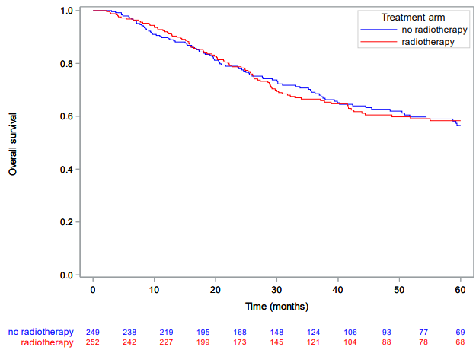
How did we treat early-stage NSCLC?
surgery
chemotherapy
RT
In prospective data,
post-operative radiation
does not improve OS
for patients with
completely resected N2 NSCLC
Le Pechoux et al, Lancet Onc 2022

Slide 15

How do we treat early-stage NSCLC?
surgery
chemotherapy
immunotherapy

Slide 16
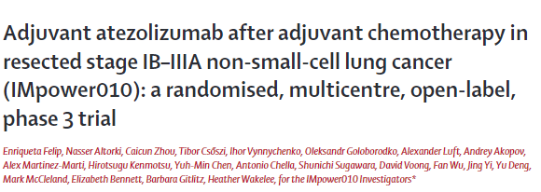
Anti-PD-L1 Ab
Atezolizumab q21 days x 16
Completely resected
IB (≥4cm) –IIIA NSCLC (AJCC v7)
1-4 cycles of platinum-based chemotherapy
Observation
Co-primary endpoints:
DFS in stage II–IIIA, PD-L1 1+%
DFS in all stage IB–IIIA population.

Slide 17
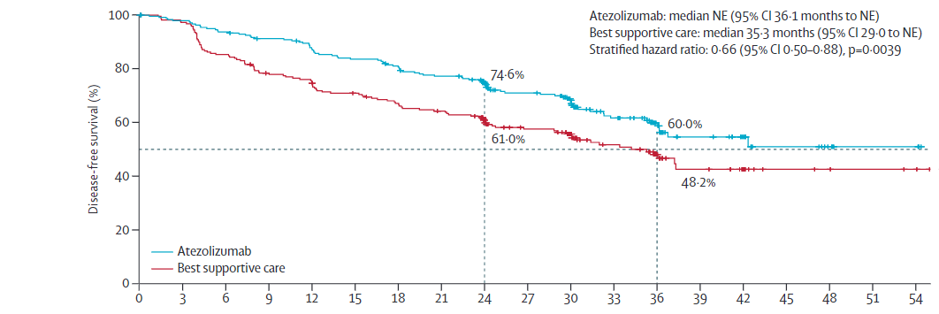
Adjuvant atezolizumab improves DFS
Felip et al, Lancet 2021

Slide 18
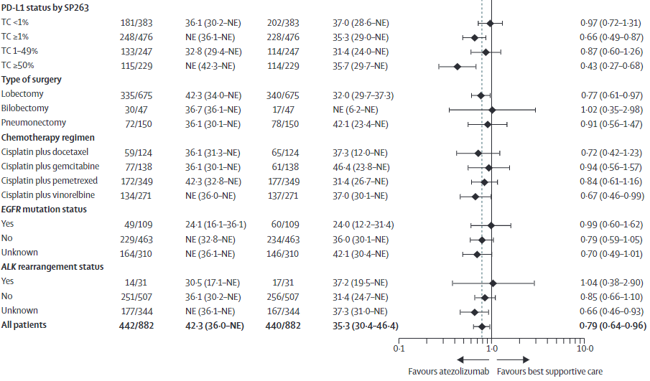
Adjuvant atezolizumab subgroup analysis suggests greatest benefit in high PD-L1
Felip et al, Lancet 2021

Slide 19
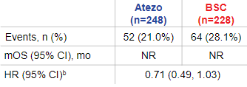
Adjuvant atezolizumab overall survival data
No OS benefit in the all-randomized Stage II–IIIA
OS interim analysis in PD-L1 TC ≥1% (Stage II–IIIA )
Wakelee H, et al. Presented at WCLC 2022/Felip et al Annals of Onc 2023

Slide 20
Adjuvant atezolizumab overall survival data
PD-L1 ≥50% (Stage II-IIIA)
excluding EGFR/ALK+
Wakelee H, et al. Presented at WCLC 2022/Felip et al Annals of Onc 2023

Slide 21
Adjuvant pembrolizumab
Key eligibility criteria:
AJCC 7 Stage IB (4cm+) II, IIIA
Complete resection
Adjuvant chemo not required, but considered for IB, strongly recommended for II-III (86% received)
Pembrolizumab
200 mg IV q3 wks x 18
Placebo
q3 wks x 18
O’Brien et al , Lancet Onc 2022

Slide 22
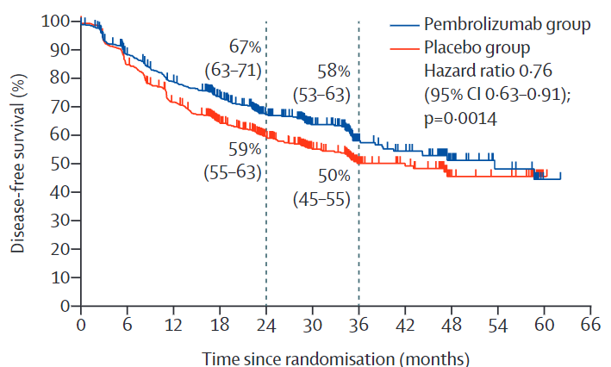
Adjuvant Pembrolizumab - Disease Free Survival
O’Brien et al , Lancet Onc 2022

Slide 23
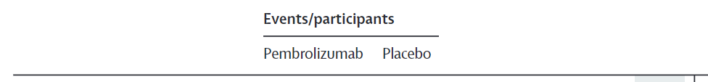
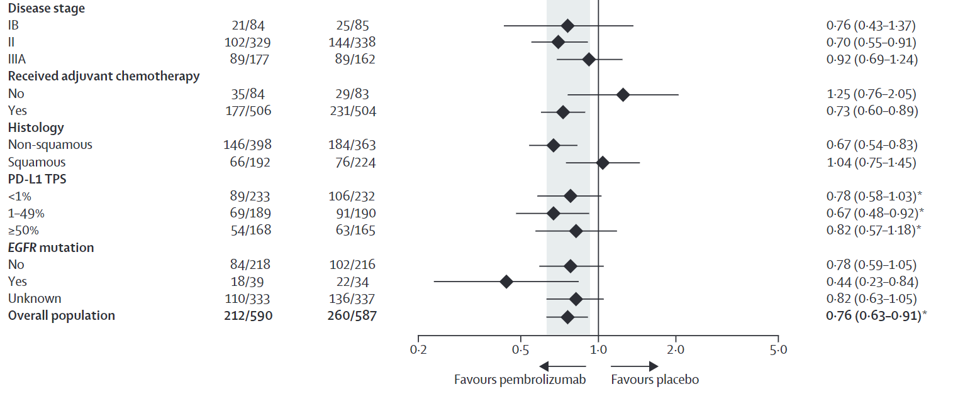
Adjuvant Pembrolizumab - Disease Free Survival subgroup analysis without a clear message on PD-L1 status
O’Brien et al , Lancet Onc 2022

Slide 24
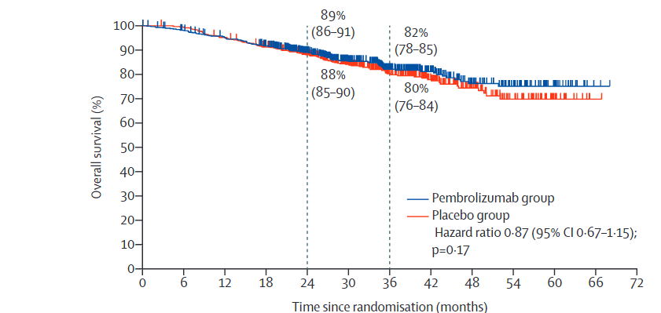
Adjuvant Pembrolizumab - Overall Survival
O’Brien et al , Lancet Onc 2022

Slide 25


How do we treat early-stage NSCLC? Adjuvant summary
surgery
chemotherapy
immunotherapy
 | DFS benefit stage II-III | DFS benefit PD-L1 ≥ 1% | DFS benefit any PD-L1 | OS benefit all patients | OS benefit PD-L1 ≥ 50%
atezolizumab
pembrolizumab

Slide 26
68 year old woman with resected Stage II (T1N1) NSCLC. Tumor histology is adenocarcinoma. No EGFR mutation. PD-L1 60%. What is the most appropriate adjuvant therapy?
Atezolizumab
Cisplatin, pemetrexed, pembrolizumab
Cisplatin, pemetrexed
Cisplatin, pemetrexed followed by atezolizumab (or pembrolizumab)
Concurrent carboplatin, paclitaxel, and radiation therapy
Adjuvant chemo improves overall survival
Adjuvant atezolizumab/pembrolizumab improve DFS, atezolizumab would improve OS, Patients in these studies generally got prior chemotherapy

Slide 27
How do we treat early-stage NSCLC?
chemotherapy
surgery
immunotherapy

Slide 28
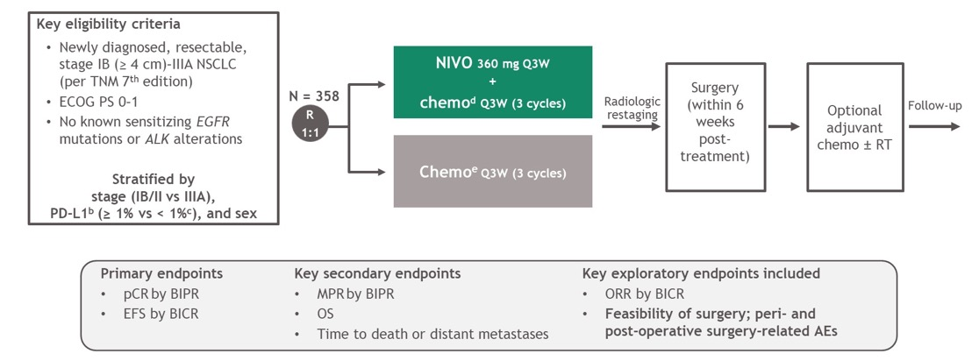
Neoadjuvant nivolumab + chemotherapy
Forde PM et al. N Engl J Med2022;386:1973-1985

Slide 29
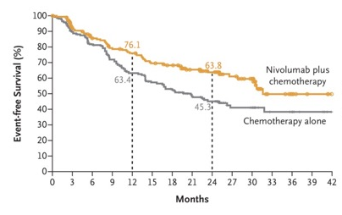
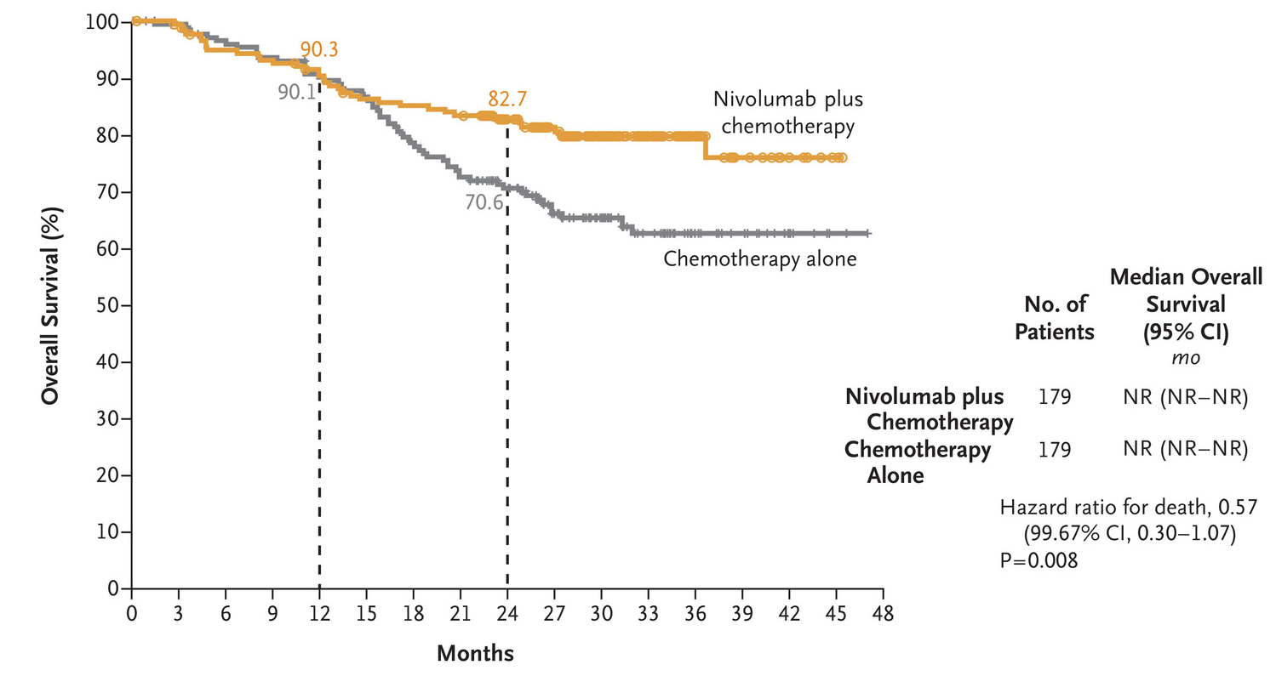
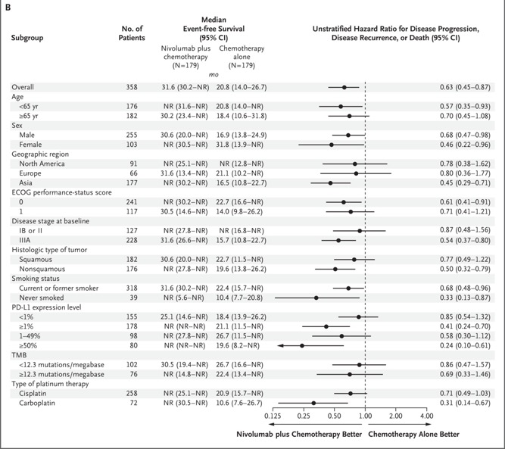
Neoadjuvant nivolumab + chemotherapy
press release says OS positive, Data TBD
Superior EFS when treated with chemotherapy + nivolumab
Forde PM et al. N Engl J Med 2022;386:1973-1985

Slide 30
Why not combine both approaches?
chemotherapy
surgery
immunotherapy
immunotherapy

Slide 31
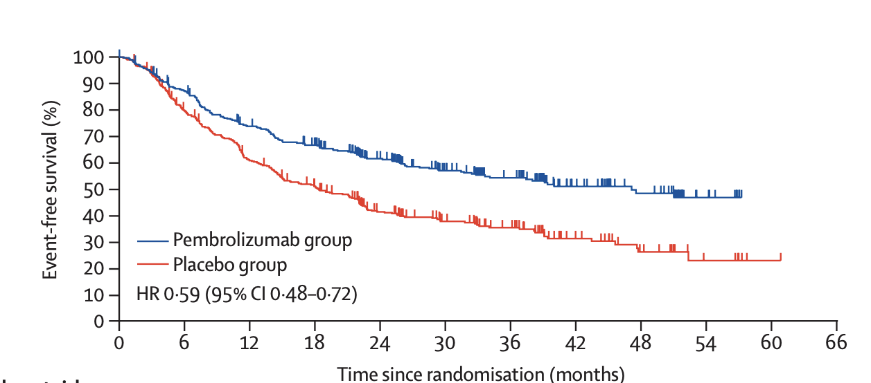
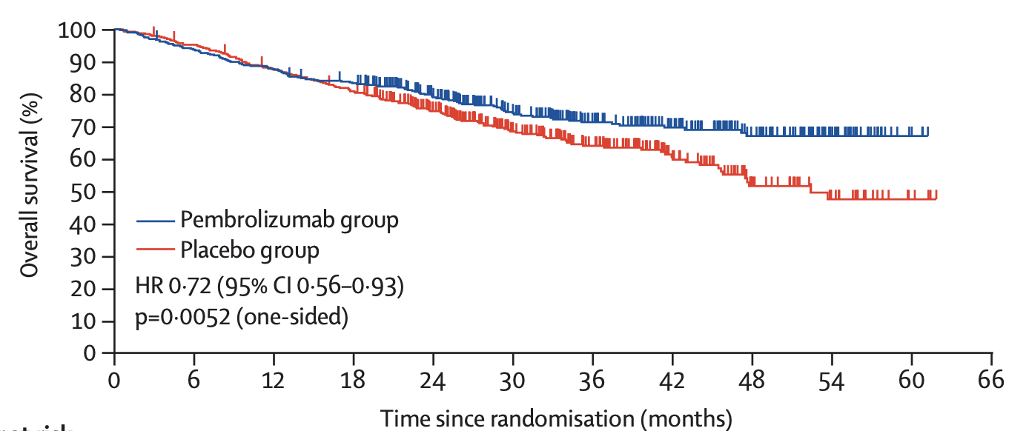
Perioperative pembrolizumab trial
Eligible patients: Resectable stage II, IIIA, or IIIB (N2 stage) NSCLC
Experimental tx: neoadjuvant pembrolizumab + cisplatin-based chemotherapy for 4 cycles, followed by surgery and adjuvant pembrolizumab q3 weeks x 13 cycles.
Spicer et al, Lancet 2024

Slide 32
How do we treat early-stage NSCLC? Perioperative therapy summary
 | EFS benefit | OS benefit
Chemo+nivo →surgery
Chemo+pembrolizumab → surgery→ pembrolizumab
Chemo+nivolumab → surgery→ nivolumab
Chemo+durvalumab→ surgery → durvalumab
*
Do you need adjuvant?
* Press release
Forde et al, NEJM 2022; Wakelee et al, NEJM 2023; Heymach et al, NEJM 2023; Spicer et al, The Lancet 2024

Slide 33
68 year-old woman with resected Stage III (T1N2) NSCLC. Tumor histology is adenocarcinoma. Tumor is found to have an EGFR mutation. What is the most appropriate adjuvant therapy?
Osimertinib
Carboplatin, paclitaxel, bevacizumab
Cisplatin, pemetrexed followed by osimertinib
Concurrent carboplatin, paclitaxel, and radiation therapy
Pembrolizumab

Slide 34
How do we treat early-stage NSCLC?
surgery
chemotherapy
Targeted therapy

Slide 35
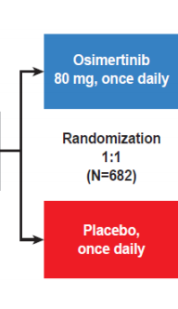
Phase III trial of adjuvant osimertinib
3rd generation EGFR TKI
Patients with:
Completely resected IB-IIIA NSCLC
EGFR exon 19 del or L858R
With or without adjuvant chemotherapy
<10 weeks from surgery (if no chemo)
<26 weeks from surgery (if adjuvant chemo)
x 3 years
Primary endpoint:
disease free survival in stage II-III
76% of stage II-II
26% of stage IB
received chemo
Modified from Wu et al NEJM 2020

Slide 36
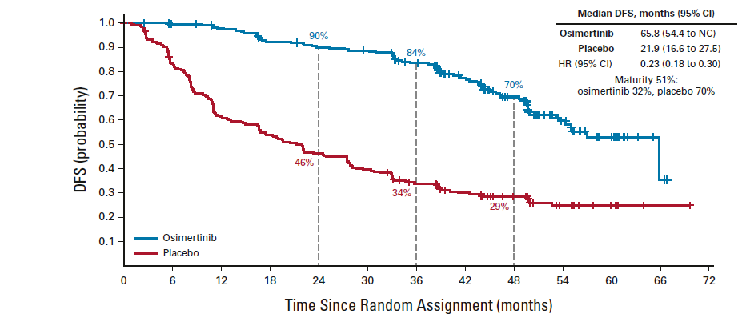
DFS for Adjuvant Osimertinib (Stage II/IIIa)
Herbst et al, JCO 2023

Slide 37
DFS for Adjuvant Osimertinib (Stage II/IIIa)
Time on osimertinib
(for osimertinib arm)
Herbst et al, JCO 2023

Slide 38
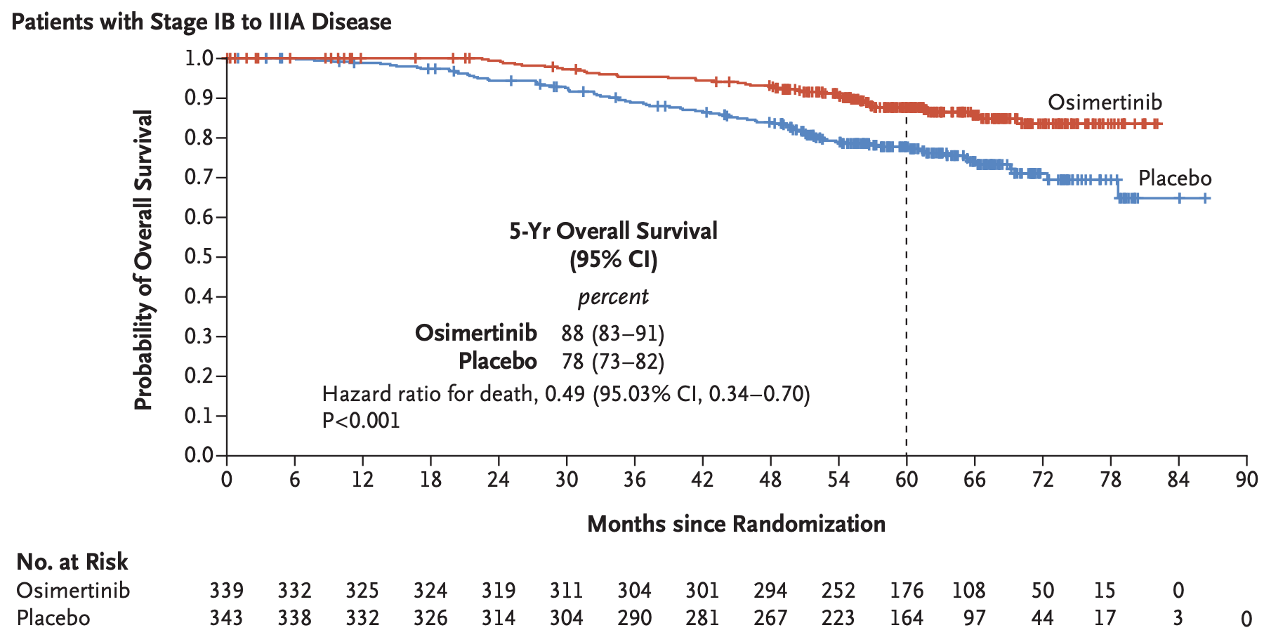
Overall Survival for Adjuvant Osimertinib
Tsuboi et al NEJM 2023

Slide 39
68 year-old woman with resected Stage III (T1N2) NSCLC. Tumor histology is adenocarcinoma. Tumor is found to have an EGFR mutation. What is the most appropriate adjuvant therapy?
Osimertinib
Carboplatin, paclitaxel, bevacizumab
Cisplatin, pemetrexed, followed by osimertinib
Concurrent carboplatin, paclitaxel, and radiation therapy
Pembrolizumab
Answer still includes cisplatin-based doublet. Cisplatin-based chemotherapy improves overall survival. Adjuvant osimertinib improves disease-free survival. We haven’t seen adjuvant checkpoint inhibitor data for EGFR mut NSCLC

Slide 40
Adjuvant alectinib for patients with ALK+ NSCLC
Resected Stage IB (≥4cm)–IIIA ALK+ NSCLC
per UICC/AJCC 7th edition
Other key eligibility criteria:
ECOG PS 0–1
Eligible to receive platinum-based chemotherapy
Adequate end-organ function
No prior systemic cancer therapy
Stratification factors:
Stage: IB (≥ 4cm) vs II vs IIIA
Race: Asian vs non-Asian
Alectinib 600 mg BID
2 years
R 1:1
Platinum-based chemotherapy†
Q3W; 4 cycles
N=257
Primary endpoint
DFS per investigator,‡ tested hierarchically:
Stage II–IIIA → ITT (Stage IB–IIIA)
Other endpoints
CNS disease-free survival
OS
Safety
Solomon et al, ESMO 2023

Slide 41
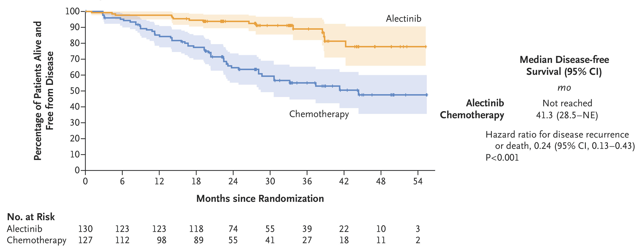
Adjuvant alectinib disease-free survival: ITT (stage IB–IIIA)
Wu et al, NEJM 2024

Slide 42
Key Points for Early-stage/Resectable Disease
Post-operative cisplatin-based chemotherapy improves overall survival for patients with Stage II and III NSCLC
After chemotherapy, if PD-L1 ≥50%, adjuvant atezolizumab improves overall survival. For all other patients, pembrolizumab improves DFS (though uncertain benefit in PD-L1 negative) and, for PD-L1 ≥1%, atezolizumab improves DFS
For patients with Stage II and III NSCLC without EGFR or ALK, pre-operative nivolumab and chemotherapy OR perioperative pembrolizumab OR perioperative durvalumab improves EFS
For patients with Stage II-III EGFR-mutant NSCLC, adjuvant osimertinib x 3 years improves DFS and OS
For patients with Stage II-III ALK positive NSCLC, adjuvant alectinib x 2 years improves DFS
No prospective data supports use of post-operative radiation therapy
Boards tip: People who write boards questions ❤️ cisplatin-based chemotherapy in the curative-disease setting…the right answer probably has it

Slide 43
What if the patient can’t have an operation?

Slide 44
Chemoradiotherapy is superior to sequential chemotherapy→ radiotherapy in Stage III NSCLC
chemotherapy
radiotherapy
P-value (log-rank): 0.038
vs
chemotherapy
radiotherapy
RTOG 9410 Curran et al, J Natl Cancer Inst, 2011

Slide 45
Unresectable Stage III NSCLC
Concomitant administration of chemotherapy and radiation is recommended for patients with good PS
Cisplatin or carboplatin-based regimens are considered appropriate
Variety of regimens are widely used:
Cisplatin, etoposide
Cisplatin, pemetrexed
Carboplatin, paclitaxel
Curran et al, J Natl Cancer Inst, 2011

Slide 46
How do we improve outcomes for unresectable stage III
chemotherapy
immunotherapy
radiotherapy

Slide 47
Evaluation of Immune Checkpoint Inhibitor after chemoRT in Stage III NSCLC
Durvalumab
10 mg/kg q2w for up to 12 months
N=476
Unresectable, Stage III NSCLC
No progression after definitive platinum-based cCRT (≥2 cycles)
PS 0 or 1
Any PD-L1 status
N=713 randomized
1–42 days post-cCRT
Primary endpoints
PFS
OS
R
Placebo
10 mg/kg q2w for up to 12 months
N=237
Antonia NEJM 2018
1. Antonia SJ, et al. N Engl J Med 2017;377:1919–29.

Slide 48
Improved Overall Survival with the Addition of Durvalumab after ChemoRT
OS HR = 0.68
99.73% CI, 0.469–0.997†
P=0.00251
1.0
83.1%
0.9
0.8
66.3%
0.7
0.6
75.3%
0.5
Probability of Overall Survival
 | No. of events / No. of patients (%) | Median OS (95% CI) months
Durvalumab | 183/476 (38.4) | NR (34.7–NR)
Placebo | 116/237 (48.9) | 28.7 (22.9–NR)
0.4
55.6%
0.3
0.2
0.1
0.0
0
3
6
9
12
15
18
21
24
27
30
33
36
39
42
45
Time from Randomization (months)
No. at Risk
Durvalumab
476
464
431
415
385
364
343
319
274
210
115
57
23
2
0
0
Placebo
237
220
198
178
170
155
141
130
117
78
42
21
9
3
1
0
*Median duration of follow-up for OS was 25.2 months (range 0.2–43.1) †Adjusted for interim analysis
Antonia NEJM 2018
NR, not reached

Slide 49
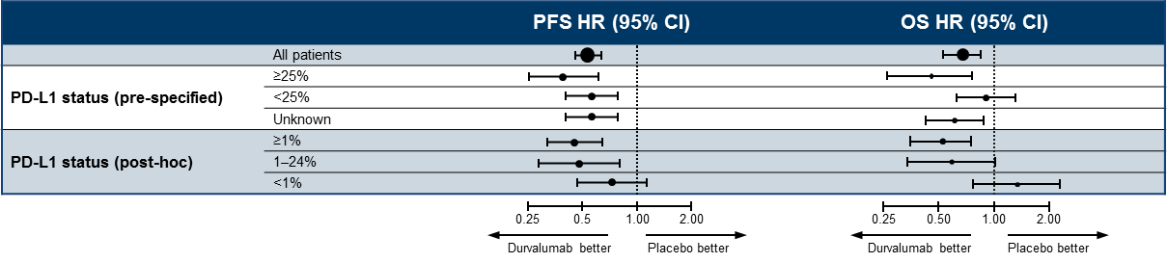
Consolidation Durvalumab: Subgroup Analysis by PD-L1 Status
Note: PFS data based on data cutoff of Feb 13, 2017, and OS data based on data cutoff of March 22, 2018
Antonia NEJM 2018

Slide 50
Add LAURA results

Slide 51
Unresectable Stage III NSCLC
Concomitant administration of chemotherapy and radiation is recommended for patients with good PS and is preferred compared to sequential chemotherapy and radiation
The addition of a year of durvalumab after concurrent radiation and chemotherapy improves overall survival
Controversy around the role of predictors of benefit to consolidation durvalumab (PD-L1, EGFR, etc)
Boards tips:
patients with grade 2 or higher pneumonitis after chemoRT were excluded from adjuvant durvalumab trial.

Slide 52
The Current Approach to First-Line Treatment of Patients with Advanced NSCLC
Stage IV NSCLC
Histologic Assessment
+
Molecular Analysis
+
PD-L1 Testing
PD-L1 <50%
~25%
of patients
EGFR, ALK
ROS1, BRAF
~45%
of patients
PD-L1 ≥50%
~30%
of patients

Slide 53
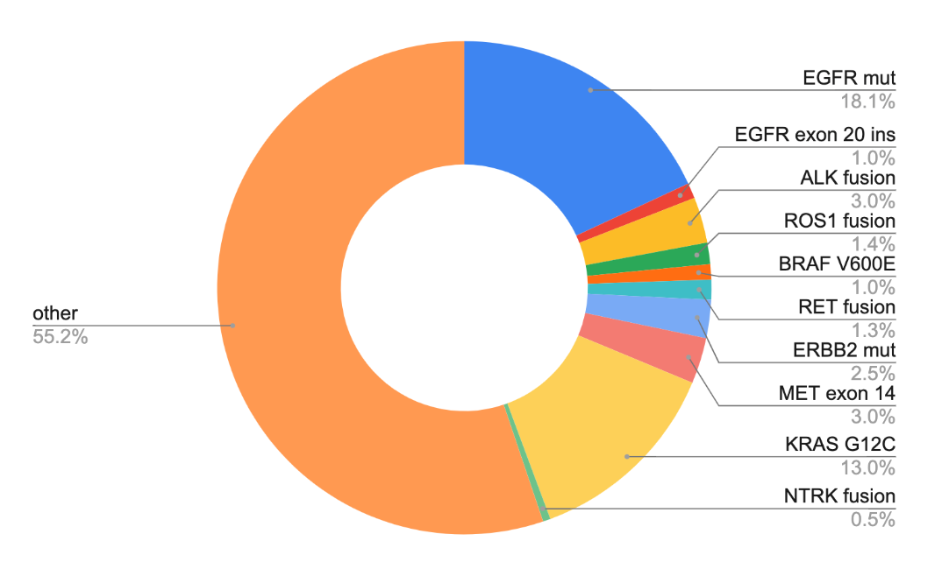
Lung cancer molecular subtypes with FDA-approved agents
AACR GENIE BPC lung, Data available at https://genie.cbioportal.org/

Slide 54
58 year-old former smoker (20 pack years) is diagnosed with stage IV NSCLC. Tumor histology is adenocarcinoma. IHC for PD-L1 is 70%. EGFR exon 19 deletion is identified. What treatment is associated with the best progression-free survival?
Cisplatin, pemetrexed, bevacizumab
Erlotinib
Pembrolizumab
Osimertinib
Carboplatin, pemetrexed, osimertinib

Slide 55
Initial Treatment of EGFR mutant NSCLC
Multiple Randomized Trials have shown that EGFR TKIs are better than Platinum-based Doublets for Patients with EGFR mutant Lung Cancer (using gefitinib, erlotinib, and afatinib)
Osimertinib has been demonstrated superior to gefitinib/erlotinib (PFS and OS)
Mok et al NEJM 2009, Maemondo et al NEJM 2010, Mitsudomi et al Lancet Oncol 2010, Rosell et al Lancet Oncol 2012

Slide 56
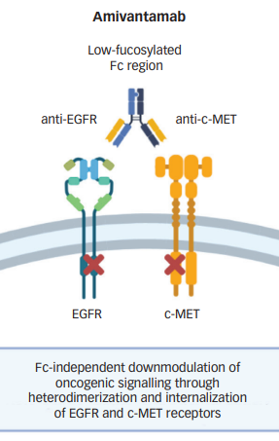
How do we improve on TKI for EGFR mut lung cancer?
Add
Chemotherapy
Dual EGFR inhibition
Platinum + Pemetrexed
+
osimertinib
amivantamab
+
lazertinib
3rd generation
EGFR TKI
Antibody
IV
Planchard et al, NEJM 2023; Cho et al, NEJM 2024
Gonzalvez et al, Can Discovery 2021; adapted from Guo et al, Touch Reviews 2021

Slide 57
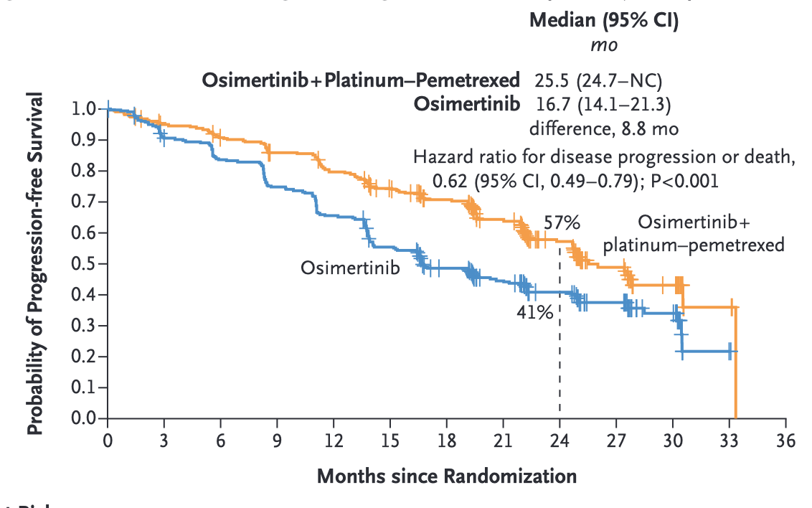
osimertinib +/- chemotherapy for EGFR mut NSCLC
Planchard et al, NEJM 2023

Slide 58
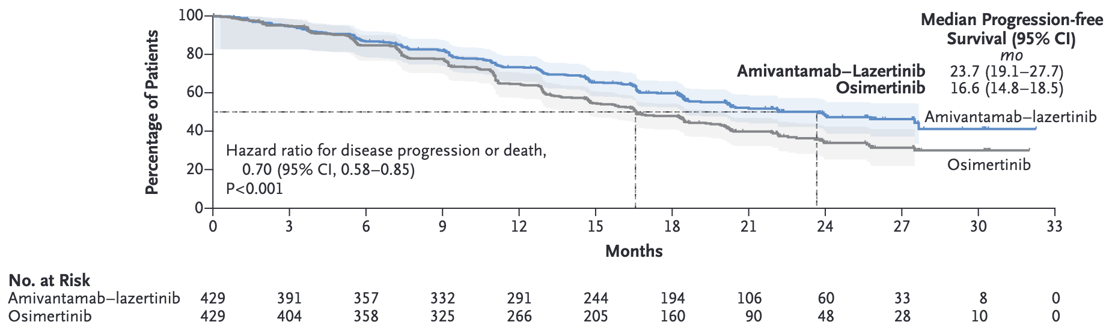
amivantamab+lazertinib improves PFS compared with osimertinib
AMI/LAZER
Cho et al, NEJM 2024

Slide 59
58 year-old former smoker (20 pack years) is diagnosed with stage IV NSCLC. Tumor histology is adenocarcinoma. IHC for PD-L1 is 70%. EGFR exon 19 deletion is identified. What treatment is associated with the best progression-free survival?
Cisplatin, pemetrexed, bevacizumab
Erlotinib
Pembrolizumab
Osimertinib
[Carboplatin, pemetrexed, osimertinib] OR [amivantamab+Lazertinib]
Osimertinib is the EGFR TKI with longest progression-free survival and overall survival. Both trials augmenting therapy beyond third gen EGFR TKI led to longer PFS, but we haven’t seen mature OS. All front-line pembrolizumab trials excluded patients with EGFR mutations.

Slide 60
Lung cancer molecular subtypes with FDA-approved agents
AACR GENIE BPC lung, Data available at https://genie.cbioportal.org/

Slide 61
58 year old former smoker (20 pack years) is diagnosed with stage IV NSCLC. Tumor histology is adenocarcinoma. IHC for PD-L1 is 70%. ALK rearrangement is identified. What treatment is associated with the best progression-free survival?
Cisplatin, pemetrexed, bevacizumab
Crizotinib
Pembrolizumab
Alectinib
Cisplatin, pemetrexed

Slide 62
Initial treatment of ALK positive NSCLC
The ALK inhibitor crizotinib was demonstrated to be superior to platinum-doublet chemotherapy.
Next generation ALK inhibitors include Alectinib, Ceritinib, Brigatinib, Lorlatinib
more selective for ALK (don’t have much effect on MET)
Can inhibit mutated ALK (a mechanism of resistance)
May have greater activity in the CNS

Slide 63
Evaluating Newer ALK inhibitors in ALK+ NSCLC
Key Entry Criteria
Stage IIIB/IV or recurrent ALK-positive NSCLC
ALK positive
ECOG PS 0-2
Brain metastases allowed
no prior therapy
Newer ALK inhibitor
Endpoints
Primary
- PFS
Secondary
- ORR
- OS
R
1:1
Crizotinib 250 mg BID PO

Slide 64
Comparing newer ALK inhibitors in ALK+ NSCLC
 | RR (vs crizotinib) | 12 month PFS (vs crizotinib) | PFS HR
Alectinib | 83% vs 76%* | 68% vs 49% | 0.47
Brigatinib | 71% vs 60% | 67% vs 43% | 0.49
Lorlatinib | 76% vs 58% | 78% vs 59% | 0.28
5-year overall survival on these trials generally >60%
*confirmed objective response rate not reported

Slide 65
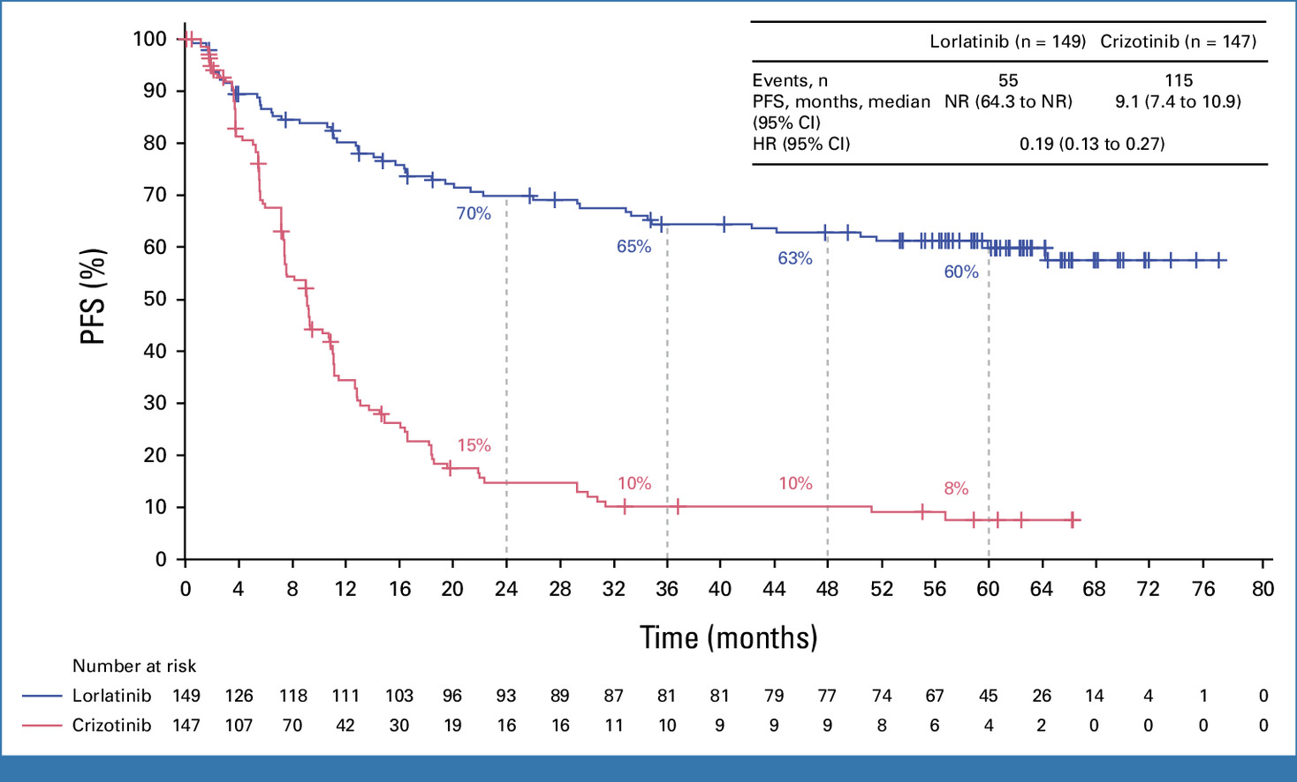
ALK inhibitors can lead to long-term responses
Solomon et al, JCO 2024

Slide 66
58 year-old former smoker (20 pack years) is diagnosed with stage IV NSCLC. Tumor histology is adenocarcinoma. IHC for PD-L1 is 70%. ALK rearrangement is identified. What treatment is associated with the best progression-free survival?
Cisplatin, pemetrexed, bevacizumab
Crizotinib
Pembrolizumab
Alectinib (or brigatinib or lorlatinib)
Cisplatin, pemetrexed
ALK inhibitors are superior to chemotherapy. 2nd/3rd generation ALK inhibitors have been studied in first-line. Brigatinib, alectinib, lorlatinib lead to better PFS than with crizotinib. All front-line checkpoint inhibitor trials excluded patients with ALK.

Slide 67
Lung cancer molecular subtypes with FDA-approved agents
AACR GENIE BPC lung, Data available at https://genie.cbioportal.org/

Slide 68
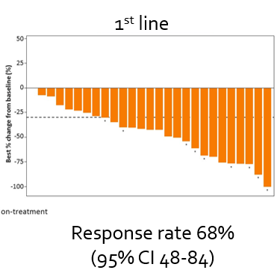
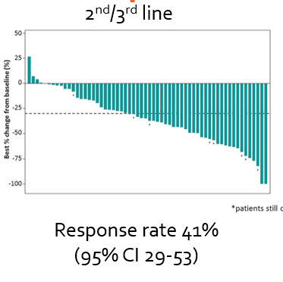
MET exon 14 NSCLC - capmatinib
Wolf et al, ASCO 2019, Capmatinib prescribing information, accessed May 2020

Slide 69
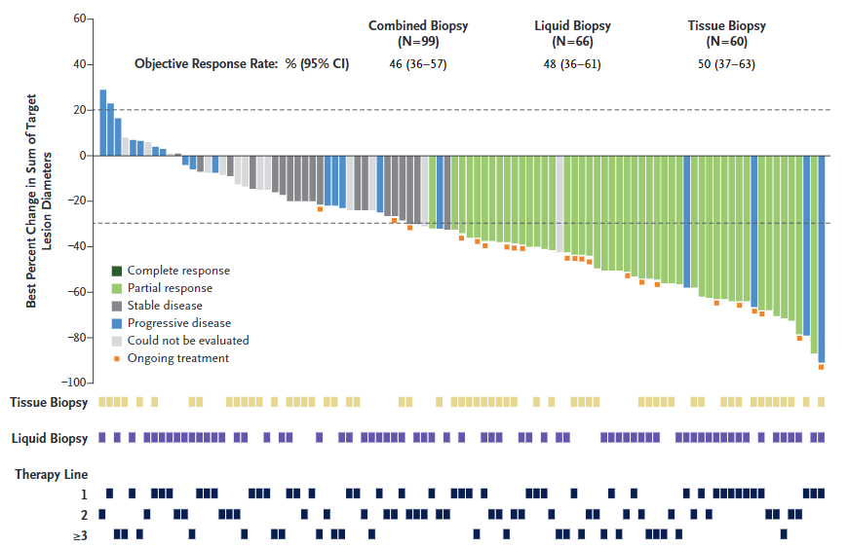
MET exon 14 NSCLC - tepotinib
Paik et al, ASCO 2020/NEJM 2020

Slide 70
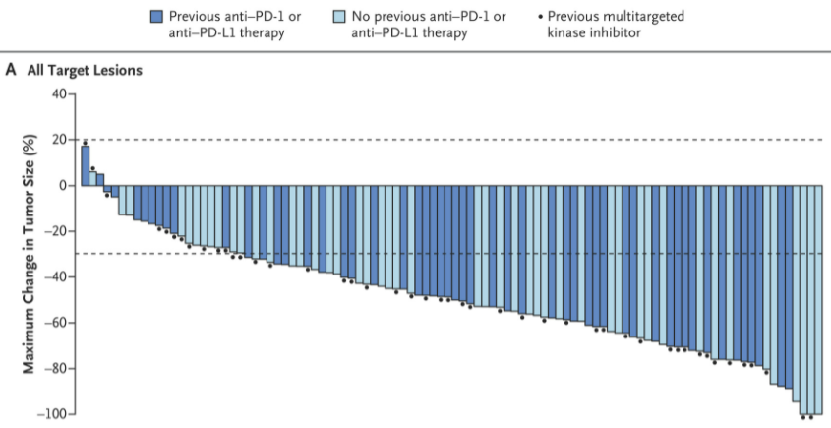
RET positive NSCLC - selpercatinib
 | 1st line | 2nd + line
RR | 85% | 64%
mPFS | NE | 17 mo
Drilon et al, NEJM 2020

Slide 71
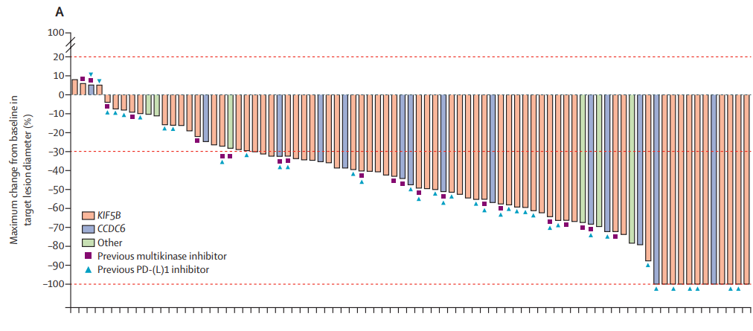
RET positive NSCLC - pralsetinib
Gainor et al, ASCO 2020, Lancet Onc 2021

Slide 72
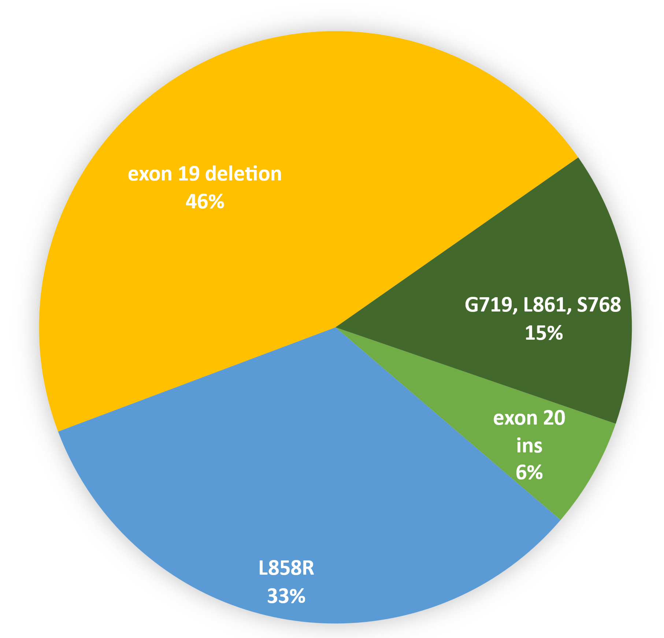
EGFR has become more complicated Among patients with EGFR mutant NSCLC…
79% of patient have classically sensitizing EGFR mutations (exon 19 deletion and L858R)
15% of patient have “atypical” EGFR mutations
6% of patient have EGFR exon 20 insertions
From AACR GENIE v 11 public, Data available at https://genie.cbioportal.org/

Slide 73
Agents for EGFR exon 20 insertion NSLC
Tyrosine kinase inhibitor
oral
Antibody
IV
Gonzalvez et al, Can Discovery 2021; adapted from Guo et al, Touch Reviews 2021

Slide 74
Agents for EGFR exon 20 insertion NSLC
Tyrosine kinase inhibitor
oral
Antibody
IV
Gonzalvez et al, Can Discovery 2021; adapted from Guo et al, Touch Reviews 2021

Slide 75
Amivantamab (EGFR – MET bi-specific Ab) as 2nd-line therapy in Patients with EGFR exon 20 insertion NSCLC
mPFS 8.3 months
mOS 22.8 months
Park et al, JCO 2021

Slide 76
Amivantamab in First Line treatment of EGFR exon 20 ins
carboplatin
pemetrexed
Recurrent/Metastatic NSCLC
EGFR Exon 20 insertion
No prior systemic therapy
N=308
Primary endpoint
PFS by BICR using RECIST v1.1
R
carboplatin
pemetrexed
+
amivantamab
Zhou et al, NEJM 2023

Slide 77
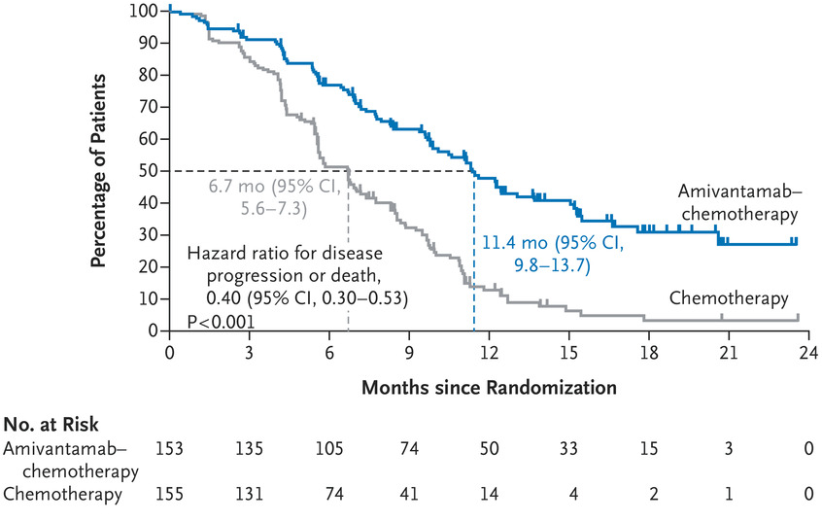
Amivantamab in first Line treatment of EGFR exon 20 ins
Zhou et al, NEJM 2023

Slide 78
Lung cancer molecular subtypes with FDA-approved agents
AACR GENIE BPC lung, Data available at https://genie.cbioportal.org/

Slide 79
NSCLC is no longer one disease – 1st line
Target | Available |  |  | Preferred 1st line
EGFR (Exon 19 del, L858R, G719, L861) | gefitinib afatinib dacomitinib | erlotinib osimertinib erlotinib + ramucirumab | Erlotinib Osimertinib Erlotinib + Ramucirumab | osimertinib
ALK fusions | crizotinib alectinib | ceritinib brigatinib lorlatinib | Ceritinib Brigatinib lorlatinib | alectinib, brigatinib
BRAF V600E | dabrafenib +trametinib |  |  | dabrafenib +trametinib
ROS1 fusions | crizotinib ceritinib |  | entrectinib lorlatinib | crizotinib, entrectinib
NTRK fusions | larotrectinib, entrectinib |  |  | larotrectinib, entrectinib
RET fusions | selpercatinib, pralsetinib |  |  | selpercatinib, pralsetinib
MET exon 14 | capmatinib, tepotinib |  |  | capmatinib, tepotinib
EGFR exon 20 ins | Amivantamab + chemotherapy (1st line)

Slide 80
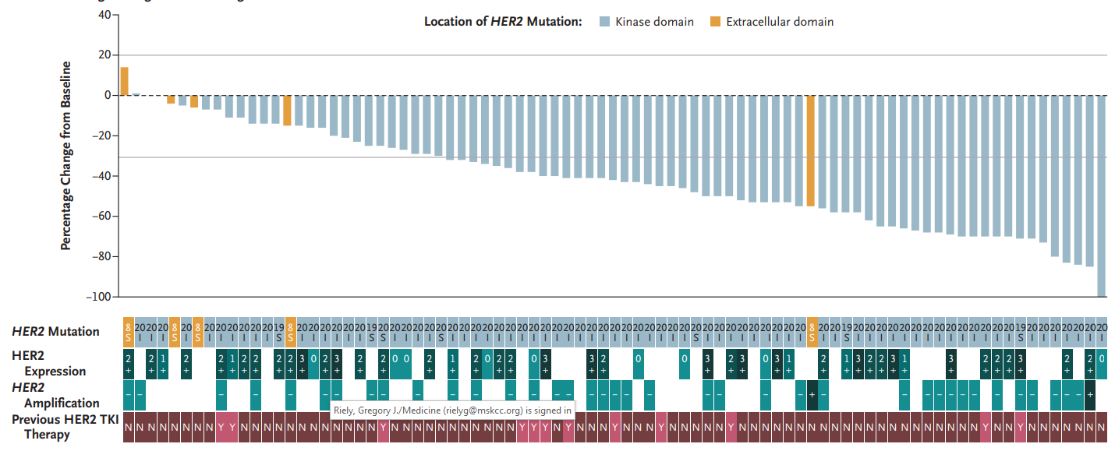
Trastuzumab Deruxtecan in Patients with Her2 Mutated NSCLC
Response Rate -50%
Li et al, NEJM 2022

Slide 81
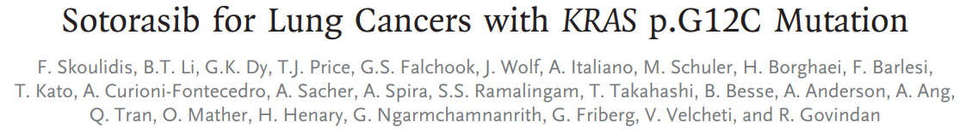
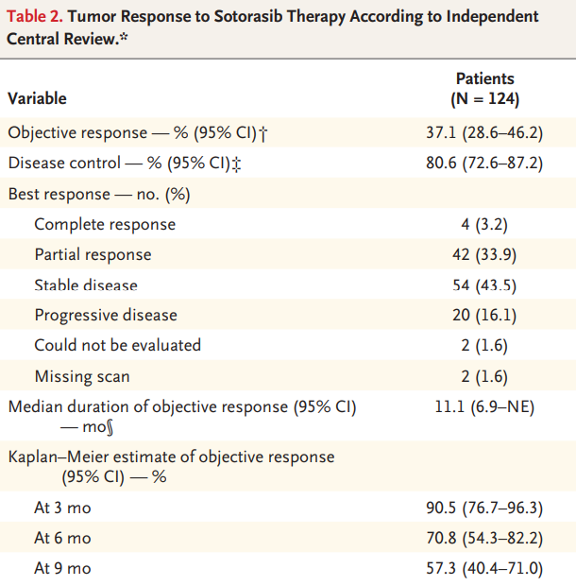
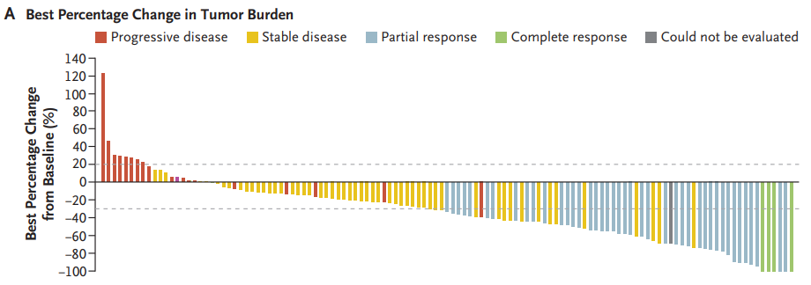
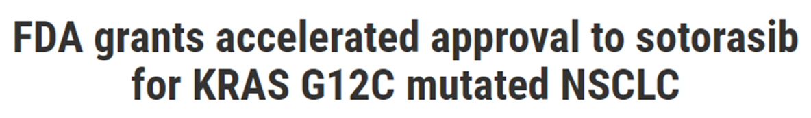
Skoulidis et al, NEJM 2021

Slide 82
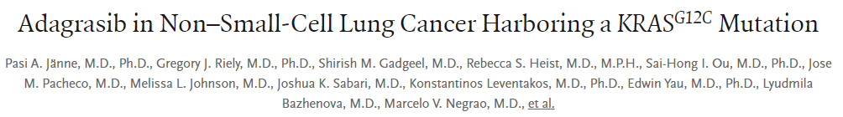
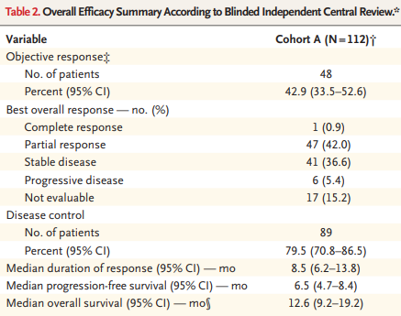
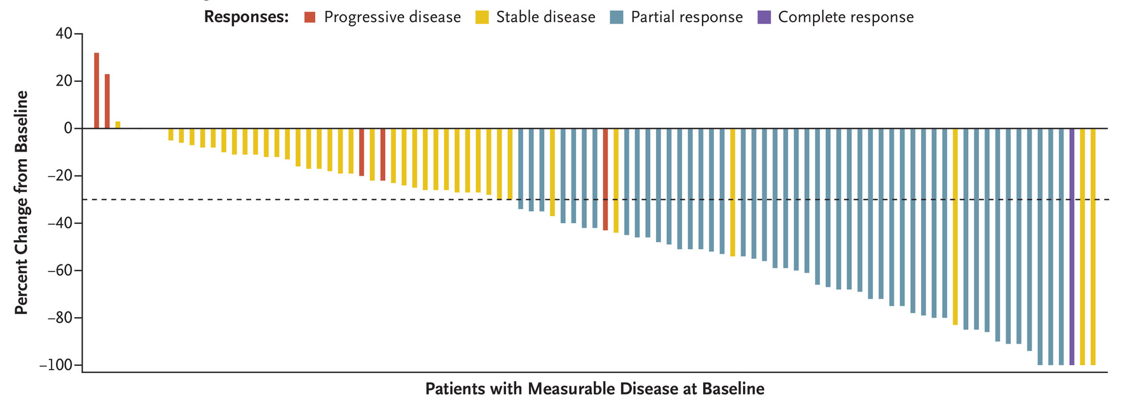
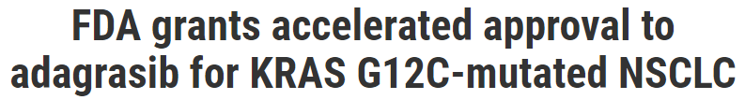
Jänne PA et al. N Engl J Med 2022;387(2):120-31.

Slide 83
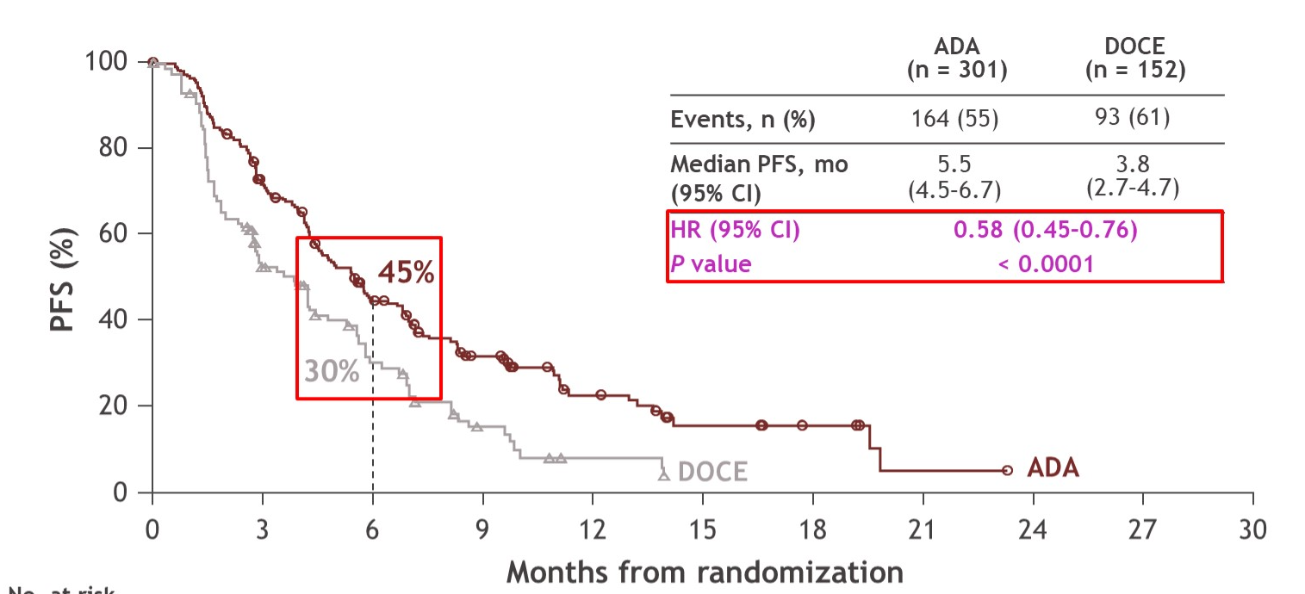
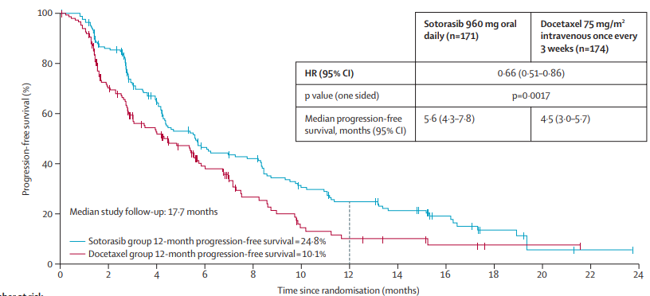
Randomized Trials targeting KRAS G12C
KRAS targeted therapy
KRAS mutant NSCLC
Previously treated with chemo/IO
docetaxel
Sotorasib
Adagrasib
Langen et al Lancet 2023
Mok et al ASCO 2024

Slide 84
NSCLC is no longer one disease – 2nd line
Target | Available drugs | Line of therapy
KRAS G12C | Sotorasib (oral) Adagrasib (oral) | 2nd line or later
HER2 (ERBB2 mutations) | Trastuzumab deruxtecan (IV) | 2nd line or later
For these targets (because of a lack of available data) patients should
Should NOT receive as first-line therapy
Should get “standard” first-line therapy

Slide 85
Molecular Summary
The standard of care in lung cancer is testing for:
EGFR, BRAF, ERBB2 (HER2) mutations, MET exon 14 alterations
ALK, ROS1, RET, and NTRK gene rearrangements
KRAS G12C mutations
Using next gen TKIs has led to better progression-free survival for patients with EGFR mutant NSCLC and ALK positive NSCLC
Adding chemotherapy to targeted agents has improved 1st line progression-free survival for some targets, though not clear that this is better than sequential approach

Slide 86
The Current Approach to First-Line Treatment of Patients with Advanced NSCLC
Stage IV NSCLC
Targeted Therapy
Histologic Assessment
+
Molecular Analysis
+
PD-L1 Testing
PD-L1 <50%
Chemotherapy +
ICI
EGFR, ALK
ROS1, BRAF
PD-L1 ≥50%
Anti-PD-(L)1 Ab
OR
Chemotherapy + ICI

Slide 87
45 year-old person with Stage IV NSCLC
Adenocarcinoma histology
KRAS G12C mutation
PD-L1 90%
Good performance status
What is the most appropriate chemotherapy?
Gemcitabine, cisplatin
Sotorasib
Pembrolizumab
Gemcitabine and docetaxel

Slide 88
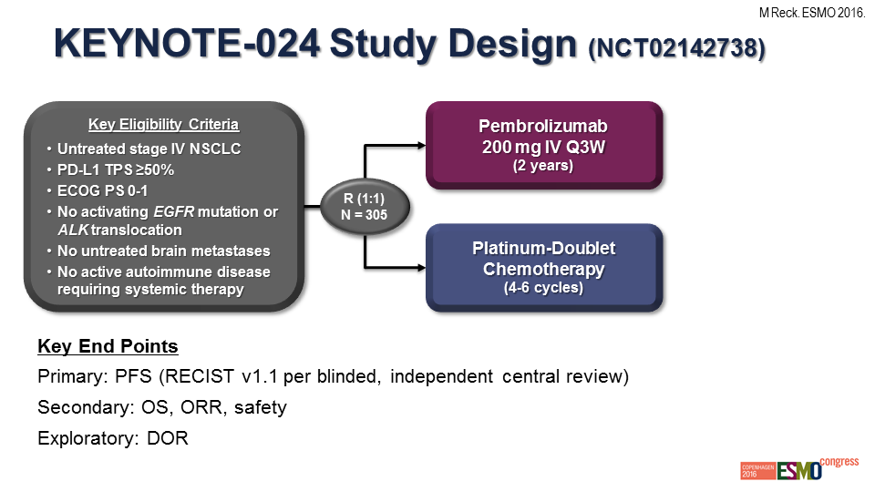
Pembrolizumab vs Chemotherapy
in Patients who are PD-L1 ≥ 50%
Reck et al, ESMO 2016

Slide 89

Pembrolizumab (anti-PD-1 Antibody) vs Chemotherapy
in Patients who are PD-L1 ≥ 50%
Reck et al, JCO 2019

Slide 90
45 year-old person with Stage IV NSCLC
Adenocarcinoma histology, EGFR, ALK, BRAF, ROS1 negative
PD-L1 90%, Good performance status
What is the most appropriate chemotherapy?
Gemcitabine, cisplatin
Sotorasib
Pembrolizumab (or atezolizumab or cemiplimab)
Gemcitabine and docetaxel
Single-agent anti-PD-1/PD-L1 is the treatment of choice for patients whose tumors show PD-L1 50% or greater (but you could do chemo + ICI).

Slide 91

What’s the best PD-L1 cutpoint for initial therapy with single-agent pembrolizumab?
PD-L1 TPS ≥ 50%
PD-L1 TPS ≥ 20%
PD-L1 TPS ≥ 1%
PD-L1 TPS 1-49%
Mok et al, Lancet 2019

Slide 92

What’s the best PD-L1 cutpoint for initial therapy with single-agent atezolizumab?
“High”
PD-L1 ≥50% on tumor cells or ≥10% immune cells
HR = 0.59 (95% CI 0.40-0.89) P=0.01
“High or Intermediate”
PD-L1 ≥5% on tumor cells or ≥5% immune cells
HR = 0.72 (95% CI 0.52-0.99) P=0.04
“Any”
PD-L1 ≥1% on tumor cells or ≥1% immune cells
HR = 0.83 (95% CI 0.65-1.07)
Herbst et al, NEJM 2020

Slide 93
What’s the best PD-L1 cutpoint for initial therapy with single-agent atezolizumab?
“High”
PD-L1 ≥50% on tumor cells or ≥10% immune cells
HR = 0.59 (95% CI 0.40-0.89) P=0.01
“High or Intermediate”
PD-L1 ≥5% on tumor cells or ≥5% immune cells
HR = 0.72 (95% CI 0.52-0.99) P=0.04
“Any”
PD-L1 ≥1% on tumor cells or ≥1% immune cells
HR = 0.83 (95% CI 0.65-1.07)
Herbst et al, NEJM 2020

Slide 94
70 year-old person with Stage IV NSCLC
Adenocarcinoma histology
EGFR, ALK, BRAF, ROS1 negative
PD-L1 90%
History of rheumatoid arthritis requiring steroids (prednisone 20 mg) in the last 6 months
What is the most appropriate chemotherapy?
Gemcitabine, cisplatin
Pemetrexed, cisplatin
Pembrolizumab
Gemcitabine and docetaxel

Slide 95
70 year-old person with Stage IV NSCLC
Adenocarcinoma histology
EGFR, ALK, BRAF, ROS1 negative
PD-L1 90%
History of rheumatoid arthritis requiring steroids (prednisone 20 mg) in the last 6 months
What is the most appropriate chemotherapy?
Gemcitabine, cisplatin
Pemetrexed, cisplatin
Pembrolizumab
Gemcitabine and docetaxel
Patients with autoimmune disease requiring steroids in past 2 years were excluded from the studies of initial immune checkpoint inhibitors. For the chemotherapy, we know that pemetrexed/cisplatin is superior to gemcitabine/cisplatin in patients with non-squamous NSCLC

Slide 96
Front Line Single-agent Checkpoint Inhibitor
In patients with NSCLC whose tumor staining shows high PD-L1 expression, pembrolizumab, atezolizumab, and cemiplimab have been shown to be better than chemotherapy
In patients with NSCLC PD-L1 ≥ 1% pembrolizumab/atezolizumab are similar to chemotherapy (and pembrolizumab is FDA-approved in this context), but at low cutpoints not clearly better than chemotherapy
For patients with high PD-L1 with significant symptoms, still reasonable to combine anti-PD-(L)1 with chemotherapy
Similar trials have been conducted in the first line setting with nivolumab and durvalumab using different cutpoints (5%, 25%) and they have been negative
Reminder: Front-line checkpoint trials excluded patients with EGFR mutations and ALK fusions

Slide 97
55 year-old person with Stage IV NSCLC
Adenocarcinoma histology
No EGFR mutation, ALK fusion
No brain metastases
Good performance status
Hemoptysis (3 tablespoons)
What is the most appropriate chemotherapy ?
Cisplatin, gemcitabine
Carboplatin, paclitaxel, bevacizumab, atezolizumab
Carboplatin, paclitaxel, bevacizumab
Carboplatin, paclitaxel, erlotinib
Cisplatin, pemetrexed, pembrolizumab

Slide 98
Trials of Chemotherapy +/- ICI in metastatic NSCLC (Generic schema)
Recurrent/metastatic [HISTOLOGY] NSCLC
no prior chemo
no EGFR+ or ALK+
sample for PD-L1 IHC status
no symptomatic brain metastases
No pneumonitis
Platinum-based chemo +ICI
4 cycles
ICI + maintenance chemo (if appropriate)
R 2:1
Platinum-based chemo
4 cycles
Placebo + maintenance chemo (if appropriate

Slide 99
Our options in patients without driver oncogene and without regard to PD-L1 expression—Squamous
pembrolizumab
Carboplatin/cisplatin, paclitaxel
Nivolumab+ipilimumab*
cemiplimab
Carboplatin/cisplatin, nab-paclitaxel
Durvalumab+tremilimumab
Carboplatin/cisplatin, gemcitabine
atezolizumab
* Can be given without chemotherapy

Slide 100
Our options in patients without driver oncogene and without regard to PD-L1 expression—non-squamous
pembrolizumab
Carboplatin/cisplatin, pemetrexed
atezolizumab
Carboplatin, paclitaxel, bevacizumab
cemiplimab
Carboplatin/cisplatin, nab-paclitaxel
Durvalumab+tremilimumab
Carboplatin/cisplatin, paclitaxel
*Ipilimumab/nivolumab
* Can be given without chemotherapy

Slide 101
55 year-old person with Stage IV NSCLC
Adenocarcinoma histology
No EGFR mutation, ALK fusion
No brain metastases
Good performance status
Hemoptysis (3 tablespoons)
What is the most appropriate chemotherapy ?
Cisplatin, gemcitabine
Carboplatin, paclitaxel, bevacizumab, atezolizumab
Carboplatin, paclitaxel, bevacizumab
Carboplatin, paclitaxel, erlotinib
Cisplatin, pemetrexed, pembrolizumab
Both chemotherapy + immunotherapy combinations were better than control.
Patients with hemoptysis should not receive bevacizumab.
Combinations of chemotherapy and TKI are always wrong (to date).

Slide 102
Front Line Combination Therapy
Numerous trials have evaluated chemotherapy + anti-PD-(L)1 therapy, most revealing a PFS and OS advantage for the combination compared with chemotherapy.
Ipilimumab + Nivolumab (alone or with 2 cycles of chemo) has also been shown to improve PFS and OS compared with chemotherapy alone.
Ipilimumab + nivolumab does NOT have improved toxicity compared with chemotherapy.
For patients with high PD-L1, reasonable to combine anti-PD-(L)1 with chemotherapy (perhaps particularly in patients with significant symptoms)
Boards tips:
-Front-line checkpoint-inhibitor/chemotherapy trials excluded patients with EGFR mutations and ALK fusions
-people who write boards questions don’t like single-agent ICI for PD-L1 1-49%

Slide 103
Key points
Stage I-III NSCLC
Cisplatin-based chemotherapy improves OS for patients with Stage II-III NSCLC
Adjuvant atezolizumab or pembrolizumab improves DFS, for PD-L1 > 50%, atezo improves OS
Adjuvant osimertinib x 3 yrs extends DFS in completely resected Stage Ib-III w/ EGFR
The addition of one year of consolidation durvalumab improves OS after ChemoRT
Biomarker evaluation is key for treatment decisions in recurrent/metastatic NSCLC
All patients with NSCLC should have PD-L1 testing and testing for relevant oncogenic drivers: EGFR, ERBB2 (HER2), BRAF, ALK, ROS1, RET, MET exon 14 and NTRK
Patients with oncogenic drivers should get targeted therapy first (EXCEPT KRAS G12C and ERBB2/HER2)
In patients without drivers, treat with chemo-immunotherapy with regimen dictated by tumor histology and comorbidities, those with PD-L1 ≥50% → ICI only is an option

Slide 104
What if a patient has high PD-L1 and an oncogenic driver?

Slide 105


Slide 106
7 patients with PD-L1 >50%
10 patients with EGFR mutation
0% Response Rate
0/10
11 patients enrolled
3 patients with PD-L1
1-49%
Lisberg et al, JTO 2018

